Slide 1

Naive vs KMP String Matching for Log File Search
A deep dive into algorithm efficiency — from brute force to elegant optimization.
Name: Sathwik Vithanala
Roll no: 25WU0102302
Class: AIML WOLVES

Slide 2
Objectives
1
2
Understand Naive Matching
Master KMP's Insight
Learn how the naive algorithm works and where it breaks down under pressure.
Discover how the failure function eliminates wasted comparisons entirely.
3
4
Compare Real Performance
Apply the Right Tool
Benchmark both algorithms against real log file scenarios with concrete numbers.
Know exactly when to reach for naive, KMP, or something even faster.

Slide 3

The Problem Statement
Log files can be massive — gigabytes of data. Finding error patterns, warnings, or specific events requires fast string matching. A naive approach can take hours; KMP can do it in seconds.
500MB
~1B
Real Scenario
Naive Worst Case
Searching for "ERROR: Connection timeout" in a production log file
Character comparisons — potentially hours of processing time
~2M
KMP Comparisons
Over 500× fewer comparisons for the same search task

Slide 4
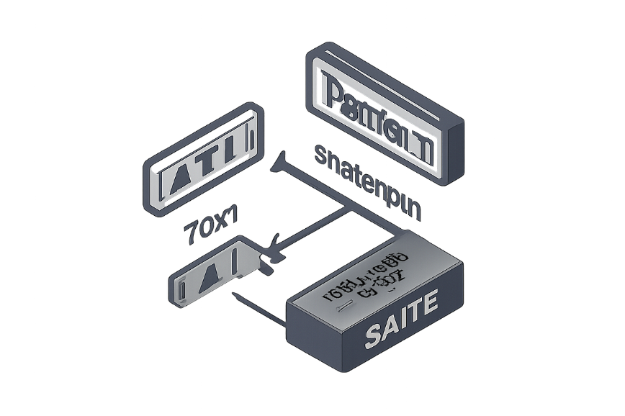
Naive Algorithm: Step-by-Step
No memory of previous comparisons. The naive string matching algorithm checks the pattern at every possible starting position in the text, comparing characters one by one.
Step 1: Start at the beginning of both text and pattern
Step 2: Compare characters one by one
Step 3: If characters match, move both pointers forward
Step 4: If characters don't match, reset the pattern pointer to start and shift the text pointer by 1
Step 5: Repeat until the pattern is found or the text ends
AAAAB example: it may match AAA first, then fail on the next character. The algorithm then shifts by one and repeats the same comparisons, which is wasteful.
Time complexity: O(n × m) worst case.

Slide 5

KMP Algorithm: Step-by-Step
LPS means Longest Proper Prefix which is also a Suffix. It tells KMP how much of the pattern can be reused after a mismatch.
Step 1: Build the LPS (failure function) table from the pattern.
Step 2: Start scanning the text from left to right.
Step 3: Compare pattern characters with text characters.
Step 4: On match, advance both pointers.
Step 5: On mismatch, use the LPS table to jump — don't restart from position 1.
Step 6: Continue until the pattern is found or the text ends.
Key advantage: Text pointer never moves backward.
Time complexity: O(n + m)

Slide 6

Why Naive Fails: Real-World Examples
The problem with naive string matching is that it keeps re-checking the same characters, which wastes time when the input contains lots of repetition.
Log File Searching
Impact: time wasted on repeated comparisons, higher CPU usage on busy systems, and slower incident response when engineers need answers fast.
Imagine searching production logs for an error message during an outage. Log lines often start with repeated timestamps, request IDs, or status prefixes, so naive matching can keep finding the same partial matches over and over before failing at the final character.
Example pattern: ERROR 500 inside a log stream full of similar prefixes like 2026-08-25 10:31:.... Each mismatch near the end forces the algorithm to restart and compare the same characters again.
On large production logs, that extra work can turn a quick search into a noticeable delay — exactly when every second matters.

Slide 7


Real-World Example 2: DNA Sequence Matching
Genetic data, like that found in DNA, contains long repetitive sequences (such as AAAAAA or repeated motifs). Searching through this data requires efficient string matching algorithms.
The Scenario
Impact: Wasted compute resources on very large genomes (billions of base pairs), significantly longer analysis times for crucial biological insights, and higher CPU usage on bioinformatics clusters.
Imagine searching for a specific gene pattern like ATGCGTATGCATGC within a massive genome sequence, which could be billions of base pairs long. Naive string matching struggles immensely here.
If our pattern is AAAAAG and the text contains long stretches of AAAAAAA..., the naive algorithm will keep comparing the same bases over and over before failing near the end of the pattern (at the 'G'). It then shifts by only one position and repeats the same set of comparisons.
For CS students interested in bioinformatics or data science, understanding these algorithmic inefficiencies is critical. Choosing the wrong algorithm can mean the difference between a research project completing in minutes or grinding on for days, delaying breakthroughs in genetic research or drug discovery.

Slide 8

KMP: The Failure Function Insight
The failure function, also called the LPS table, tells KMP how much of the pattern can be reused after a mismatch. Instead of starting over, KMP jumps to the next best match position.
What is LPS? LPS stands for Longest Proper Prefix that is also a Suffix.
Why do we need it? It tells us where to jump when the current match fails.
How does it work? We precompute a table for the pattern before searching the text.
What does it tell us? It shows how many characters can be reused after a mismatch.
Example: AAAAB
For the pattern AAAAB, the LPS table is [0, 1, 2, 3, 0].
This means the first four characters build on repeated prefixes, but the final B breaks the pattern and resets reuse to 0.
Main advantage: The text pointer never moves backward.
Because KMP uses the LPS table, it runs in O(n + m) time, where n is the text length and m is the pattern length.

Slide 9
Key Takeaways
Use KMP when you need fast pattern matching with no backtracking in the text.
Use Rabin-Karp when you want a simple rolling-hash approach that can compare many patterns efficiently.
Both algorithms are powerful tools for string search, but they shine in different situations.
Try both on sample problems to build intuition and see which one fits best.
Keep experimenting — the best way to master string matching is to practice with real examples.

